Slide 1
Domino's Sales Intelligence
Project Focus
Business Case Study | 2024-2025
Understand revenue trends and seasonality.
Identify top cities, products, and ordering patterns.
Analyze discount and channel performance.
Create a portfolio-ready business story.
An end-to-end business analysis project using Excel, SQL Server, and Power BI to understand revenue trends, product performance, discount impact, and customer behavior.
₹55.07M
50K
21K
Total Revenue
Transactions
Customers
Presented by : Atul Singh Chouhan
Excel
SQL Server
Power BI
Prepared for portfolio and interview presentation

Slide 2
Domino's Sales Intelligence
2
Project Objectives
02
Growth Performance
Product Mix
Discount Strategy
Increase revenue by identifying the products, cities, and channels that drive sales.
Understand monthly seasonality and peak ordering periods.
Use actionable insights to improve planning, staffing, and promotions.
Not all pizzas contribute equally to revenue.
Evaluate high-performing and low-performing pizzas by revenue and quantity.
Use category and size analysis to prioritize inventory and menu decisions.
Discounting can attract customers but may reduce efficiency if overused.
Analyze how discount tiers affect orders and revenue.
Recommend a balanced discount framework that supports growth and protects value.

Slide 3
Domino's Sales Intelligence
3
Dataset Overview
03
50K
23
9
50+
Transactions
Columns
Cities
Pizzas
Order Data
Customer Data
Product Data
Promotion Data
order_id
order_date
order_time
store_id
customer_id
city
payment_method
pizza_name
category
size
quantity
unit_price
discount
gst
discount_category
order_value
Why this dataset works
One clean fact table connects time, product, customer, channel, and discount information in a single dataset — perfect for analysis and dashboarding.

Slide 4
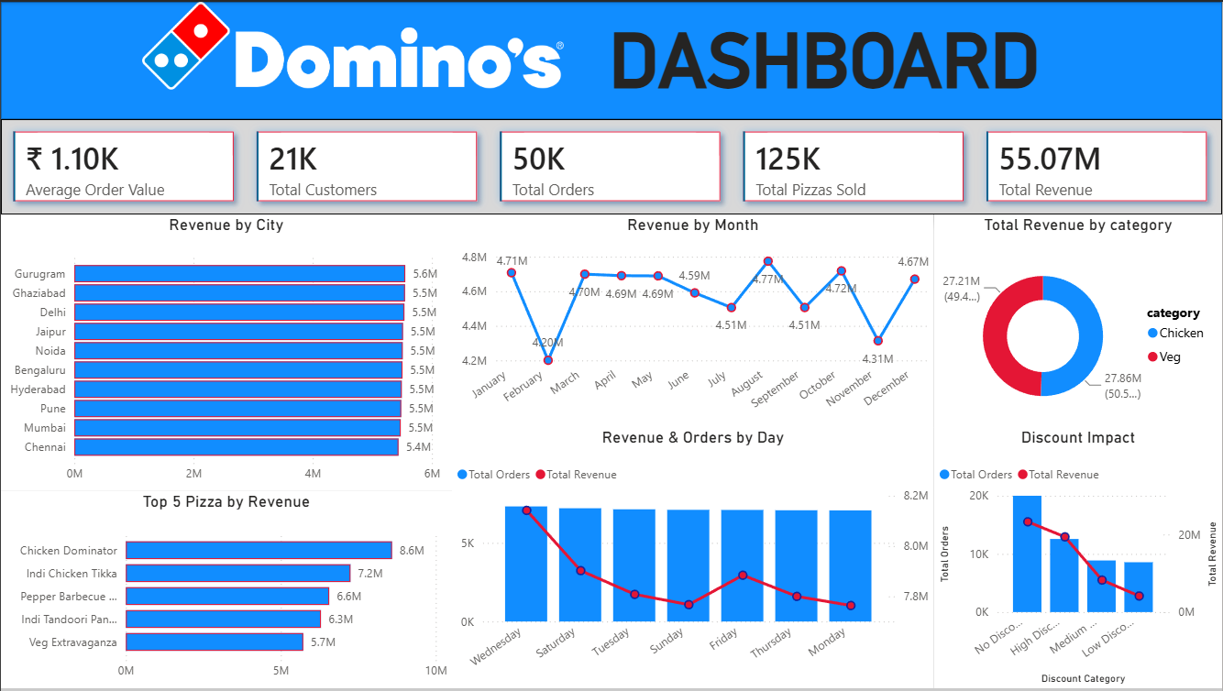
Domino's Sales Intelligence
4
Power BI Dashboard Snapshot
04
What the dashboard shows
KPI cards for revenue, orders, AOV, pizzas sold, and customers.
Trend views for month, city, day, category, and discounts.
Interactive filters
Year, Month, City, Category, Order Type, and Size slicers update the visuals.
Use in presentation
This slide works as the visual proof that the analysis is complete and interactive.
Use this slide as the visual proof slide in the case study PPT.

Slide 5
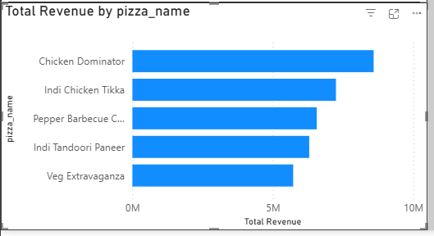
Domino's Sales Intelligence
5
Product Category Performance
05
Revenue by Pizza
What this means
Chicken Dominator leads the menu by revenue.
Indi Chicken Tikka and Pepper Barbecue Chicken follow closely.
High-revenue products should be stocked and promoted first.
The product mix is concentrated around a few high-performing pizzas.
A focused menu strategy can support promotions, inventory planning, and combo design.
Use the top pizzas as anchors for advertising and bundle offers.
Category mix
Chicken contributes slightly more revenue than Veg.
The split is balanced enough to compare category performance fairly.

Slide 6
Domino's Sales Intelligence
6
Demand Pattern & Ordering Behavior
06
Midweek
Peak Hour Window
Operational actions
Strongest demand day pattern
Ordering activity clusters around the high-traffic evening period.
The dashboard shows the busiest stretch around 6 PM–9 PM.
Increase staffing on the strongest days.
Prepare inventory before the evening rush.
Schedule promotions when customer traffic is naturally higher.
Use order-time analysis to improve delivery planning.
Revenue & Orders by Day
Wednesday is the strongest day in the dashboard.
The pattern suggests that demand builds through the workweek and peaks midweek.
Use this insight for staffing, inventory, and delivery planning.
Why it matters
Peak windows require more delivery capacity.
Store operations should be aligned with time-of-day demand.
This helps reduce delays and improve customer experience.

Slide 7
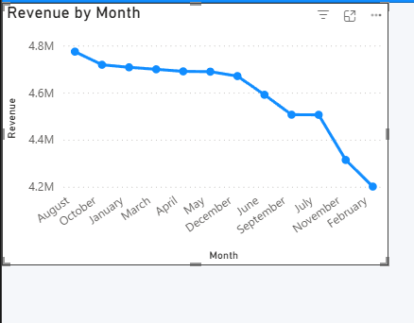
Domino's Sales Intelligence
7
Monthly Sales Trend & Seasonality
07
Peak & slow months
August is the strongest month at around ₹4.77M.
February is the weakest month at around ₹4.20M.
Seasonality insight
Revenue stays in a fairly narrow band, which suggests a stable demand base.
Seasonal peaks can be used for targeted campaigns and stock planning.
Business action
Use weaker months for promotions and stronger months for demand capture.

Slide 8
Domino's Sales Intelligence
8
Discount Impact on Revenue
08
What the pattern suggests
Business conclusion
No Discount contributes the largest share of revenue.
Revenue declines as discount tiers increase.
Deep discounts should be used carefully, not routinely.
Discounting can lift order volume, but it should not erode value unnecessarily.
The best strategy is to balance traffic growth with revenue protection.
Track discount tiers by revenue, orders, and average order value before scaling offers.
Recommendation
Use targeted discounts for selected products or customer groups.
Reserve stronger discounts for clearance or acquisition campaigns.
No Discount
High Disc.
Medium
Low Disc.

Slide 9
Domino's Sales Intelligence
9
Location Performance
09
Top locations
Bottom locations
Targeted intervention
Gurugram, Ghaziabad, Delhi, Jaipur, Noida
These cities appear at the top of the revenue ranking.
Strong locations should be used for premium product launches and campaigns.
Track the lower-performing cities or stores separately.
They may need hyperlocal marketing, assortment tuning, or improved visibility.
Use location-specific promotions.
Adjust inventory according to local demand.
Review store performance regularly to close the gap.

Slide 10
Domino's Sales Intelligence
10
Customer Segmentation & Targeted Strategies
10
Loyal Customers
New Customers
Shop frequently, high order value, prefer digital payments.
Strategy: rewards, exclusive offers, birthday benefits.
First-time buyers with potential to return.
Strategy: welcome offers and follow-up reminders.
Occasional Buyers
Bargain Hunters
Purchase during select periods or campaigns.
Strategy: seasonal bundles and reactivation.
Respond strongly to deep discounts.
Strategy: flash sales and clearance offers.
Segmentation helps tailor offers, improve retention, and avoid one-size-fits-all promotions.
Segmentation helps tailor offers, improve retention, and avoid one-size-fits-all promotions.

Slide 11
Domino's Sales Intelligence
11
Strategic Recommendations
11
Quick wins (0–3 months)
Long-term strategies (3–12 months)
Launch day-of-week and evening flash promotions.
Use SMS/WhatsApp reminders before the strongest ordering periods.
Create bundle offers to lift basket size.
Target underperforming locations with local ads.
Build a real-time Power BI dashboard for ongoing tracking.
Review product mix and discount policy quarterly.
Strengthen store-level performance monitoring.
Use historical trends to support planning and campaigns.
Why these actions matter
They convert the analysis into practical business action.
They improve revenue, operational planning, and customer engagement.
They make the project stronger for interviews and portfolio presentation.

Slide 12
Domino's Sales Intelligence
12
Conclusion
12
What this project delivers
Final takeaway
A clear view of sales performance across time, products, cities, and channels.
A clean workflow from Excel cleaning to SQL analysis and Power BI reporting.
A business story that explains what happened, why it happened, and what the business should do next.
This Domino's case study shows how raw transactional data can be turned into business decisions.
The project is designed to be concise, polished, and presentation-ready for interviews and GitHub.
Thank you.
Presented by : Atul Singh Chouhan
Prepared for portfolio and interview discussion.

